Slide 1
ISA
Dr. Rajib Ranjan Maiti
CSIS, BITS-Pilani, Hyderabad
Disclaimer: To know the complete syllabus, handout and the text book should be consulted

Slide 2
Teaching Policy and Logistics
Lab Test 1 and 2 (Tentative: 6th Oct & 1st Dec (5:15PM – 6:15PM)
Code Writing (2) + Error free sample test case (3) + TC1 (5) + TC2 (5) + TC3 (5) = 20 marks
Quiz 1 and 2 (Tentative: 3rd Oct & 28 Nov 5:15PM – 5:35PM)
10 x 1 = 10 marks (MCQ)
Mid Sem Pattern (14/10 9:30 – 11:00)
1x12 + 8x2x3 = 60 marks (either 0 or full marks for each question)
Compre Pattern (20/12 9:30 – 12:30)
1x20 + 10x2x3 = 80 marks (either 0 or full marks for each question)
Key release immediately after exam
Key verification time : 24 hours after key release
Key release on notice board in front of H101
Make up :
no make up for Quiz and Lab Test

Slide 3
Language of the Computer
To command a computer’s hardware,
you must speak its language.
The words of a computer’s language are called
instructions
The vocabulary of this language is called an
Instruction set
Once you learn one instruction set, then you will learn others easily
We choose
The instruction set developed by MIPS Technologies, designed since the 1980s
Other instructions sets are
ARMv7 : similar to MIPS
Intel x86 : used in both the PC and the cloud
ARMv8 : extends the address size of the ARMv7 from 32 bits to 64 bits

Slide 4
Classes of Parallelism and Parallel Architectures
Four ways to exploit
Instruction-level parallelism:
exploits data-level parallelism, using ideas like pipelining and speculative execution
Vector architectures, graphic processor units (GPUs), and multimedia instruction sets:
exploit data-level parallelism, using ideas like applying a single instruction to a collection of data in parallel
Thread-level parallelism:
exploits either data-level parallelism or task-level parallelism, using ideas like interaction between parallel threads
Request-level parallelism:
exploits parallelism among largely decoupled tasks specified by the programmer or the operating system.

Slide 5
Classes of Parallelism and Parallel Architectures
Flynn (1966) studied the parallel computing efforts in the 1960s,
He found a simple classification that we follow till date
The parallelism in the instruction and data streams falls under one of four categories:
Single instruction stream, single data stream (SISD)—
The programmer thinks of it as the standard sequential computer, but it can exploit ILP using superscalar and speculative execution.
Single instruction stream, multiple data streams (SIMD)—
The same instruction is executed by multiple processors using different data streams, exploits data-level parallelism using vector architectures, multimedia extensions to standard instruction sets, and GPUs.
Multiple instruction streams, single data stream (MISD)—
No commercial multiprocessor of this type has been built to date
Multiple instruction streams, multiple data streams (MIMD)—
Each processor fetches its own instructions and operates on its own data, and it targets task-level parallelism.

Slide 6
Defining Computer Architecture

Slide 7
Designing a computer
Objective:
Maximize performance and energy efficiency while staying within cost, power, and availability constraints
How to achieve the objective?
Tasks include
instruction set design, functional organization, logic design, and implementation.
The implementation : encompass integrated circuit design, packaging, power, and cooling.
Traditionally,
Computer architecture broadly indicates only instruction set design
But, other challenges are equally important, like
Memory organization and
the design of CPU (where arithmetic, logic, branching, and data transfer are implemented)
For example, two processors AMD Opteron and the Intel Core i7 use
the same instruction set architectures (80x86 instruction set, i386, i486 and i686 architectures are grouped into x86)
but different organizations (in terms of pipeline and cache organizations)

Slide 8
Seven dimensions of an ISA
Class of ISA
Nearly all ISAs today are classified as general-purpose register architectures, where the operands are either registers or memory locations
Memory addressing
Virtually all desktop and server computers, including the 80x86, ARMv8, and RISC-V, use byte addressing to access memory operands
Addressing modes
specify the address of a memory object, e.g., Register, Immediate, Displacement
Types and sizes of operands
Supported operand sizes are 8-bit, 16-bit, 32-bit (int or float), 64-bit (int or double), 80-bit (extended double)
Operations
data transfer, arithmetic logical, control, and floating point
Control flow instructions
support for conditional branches, unconditional jumps, procedure calls, and returns
Encoding an ISA
Two basic choices of encoding: fixed length and variable length

Slide 9
MIPS: Microprocessor without Interlocked Pipeline Stages

Slide 10
MIPS Computer Systems Inc.
To command a computer’s hardware, you must speak its language
MIPS Computer Systems Inc.
Founded in 1984 by a group of researchers from Stanford University
Including John L. Hennessy and Chris Rowen.
Other principal founders: Skip Stritter (formerly a Motorola technologist) and John Moussouris (formerly of IBM)
These researchers had worked on a project called MIPS
MIPS: Microprocessor without Interlocked Pipeline Stages
This is one of the projects that pioneered the RISC concept

Slide 11
Operations of the Computer Hardware
Arithmetic operations
add a, b, c # a ← b + c
How to perform a = b + c + d +e?
add a, b, c # a ← b + c
add a, a, d # a ← a + d
add a, a, e # a ← a + e
32 Registers
$s0–$s7, $t0–$t9, $zero, $a0–$a3, $v0–$v1, $gp, $fp, $sp, $ra, $at
In MIPS,
data must be in registers to perform arithmetic;
register $zero always equals 0; register $at is reserved by the assembler to handle large constants.
2³⁰ memory words
Memory[0], Memory[4], . . . , Memory[4294967292]
Accessed only by data transfer instructions;
MIPS uses byte addresses, so sequential word addresses differ by 4;
Memory holds data structures, arrays, and spilled registers.

Slide 12
MIPS assembly language: sample instructions
Category | Instruction | Example | Meaning | Comments
Arithmetic | add | add $s1, $s2, $s3 | $s1 ← $s2 + $s3 | Three register operands
 | add immediate | addi $s1,$s2,20 | $s1 = $s2 + 20 | Used to add constants
Data transfer | load word | lw $s1,20($s2) | $s1 = Memory[$s2 + 20] | Word from memory to register
 | load half | lh $s1,20($s2) | $s1 = Memory[$s2 + 20] | Halfword memory to register
 | load half unsigned | lhu $s1,20($s2) | $s1 = Memory[$s2 + 20] | Halfword memory to register
 | load linked word | ll $s1,20($s2) | $s1 = Memory[$s2 + 20] | Load word as 1st half of atomic swap
 | load upper immed. | lui $s1,20 | $s1 = 20 * 2¹⁶ | Loads constant in upper 16 bits
Logical | and | and $s1,$s2,$s3 | $s1 = $s2 & $s3 | Three reg. operands; bit-by-bit AND
 | and immediate | andi $s1,$s2,20 | $s1 = $s2 & 20 | Bit-by-bit AND reg with constant
 | shift left logical | sll $s1,$s2,10 | $s1 = $s2 << 10 | Shift left by constant
Cond. branch | branch on equal | beq $s1,$s2,25 | if ($s1 == $s2) go to PC + 4 + 100 | Equal test; PC-relative branch
 | set on less than | slt $s1,$s2,$s3 | if ($s2 < $s3) $s1 = 1; else $s1 = 0 | Compare less than; for beq, bne
Uncond. jump | jump | j 2500 | go to 10000 | Jump to target address

Slide 13
Compiling a Complex C Assignment into MIPS
A somewhat complex statement contains the fi ve variables f, g, h, i, and j:
f = (g + h) – (i + j);
What might a C compiler produce?

Slide 14
Compiling a Complex C Assignment into MIPS
A somewhat complex statement contains the fi ve variables f, g, h, i, and j:
f = (g + h) – (i + j);
What might a C compiler produce?
Ans.
add t0,g,h # temporary variable t0 contains g + h
add t1,i,j # temporary variable t1 contains i + j
sub f,t0,t1 # f gets t0 – t1, which is (g + h) – (i + j)

Slide 15
Compiling a Complex C Assignment into MIPS
A somewhat complex statement contains the fi ve variables f, g, h, i, and j:
f = (g + h) – (i + j);
What might a C compiler produce?
Ans.
add t0,g,h # temporary variable t0 contains g + h
add t1,i,j # temporary variable t1 contains i + j
sub f,t0,t1 # f gets t0 – t1, which is (g + h) – (i + j)
Assume that the variables f, g, h, i, and j are assigned to the registers $s0, $s1, $s2, $s3, and $s4, respectively.
What is the compiled MIPS code?

Slide 16
Compiling a Complex C Assignment into MIPS
A somewhat complex statement contains the fi ve variables f, g, h, i, and j:
f = (g + h) – (i + j);
What might a C compiler produce?
Ans.
add t0,g,h # temporary variable t0 contains g + h
add t1,i,j # temporary variable t1 contains i + j
sub f,t0,t1 # f gets t0 – t1, which is (g + h) – (i + j)
Assume that the variables f, g, h, i, and j are assigned to the registers $s0, $s1, $s2, $s3, and $s4, respectively.
What is the compiled MIPS code?
Ans.
add $t0,$s1,$s2 # register $t0 contains g + h
add $t1,$s3,$s4 # register $t1 contains i + j
sub $s0,$t0,$t1 # f gets $t0 – $t1, which is (g + h)–(i + j)

Slide 17
Memory access or pointers
Compile this C assignment statement:
g = h + A[8];
In MIPS
Assume that the starting address, or base address, of the array is in $s3
The address of this array element is the sum of the base of the array A, found in register $s3, plus the number to select element 8.
lw $t0,8($s3) # Temporary reg $t0 gets A[8]
add $s1,$s2,$t0 # g = h + A[8]
How about this?
What is the MIPS assembly code for the C assignment statement below?
A[12] = h + A[8];

Slide 18
Binary to Decimal Conversion
What is the decimal value of this 32-bit two’s complement number?
(1111 1111 1111 1111 1111 1111 1111 1100)_{two}
Ans.
(-4)₁₀

Slide 19
Sign Extension
Convert 16-bit binary versions of 2₁₀ and -2₁₀ to 32-bit binary numbers.

Slide 20
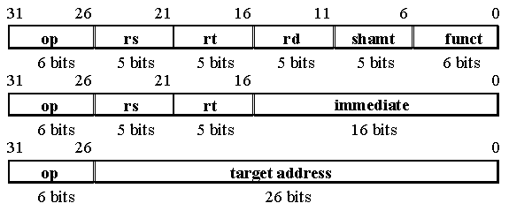
Representing Instructions in MIPS 32 bits
least significant bit (LSB): The rightmost bit in a MIPS word.
most significant bit (MSB): The left most bit in a MIPS word.
31 | 30 | 29 | 28 | 27 | 26 | 25 | 24 | 23 | 22 | 21 | 20 | 19 | 18 | 17 | 16 | 15 | 14 | 13 | 12 | 11 | 10 | 9 | 8 | 7 | 6 | 5 | 4 | 3 | 2 | 1 | 0
0 | 0 | 0 | 0 | 0 | 0 | 0 | 0 | 0 | 0 | 0 | 0 | 0 | 0 | 0 | 0 | 0 | 0 | 0 | 0 | 0 | 0 | 0 | 0 | 0 | 0 | 0 | 0 | 1 | 0 | 1 | 1
Representation of 1011₂ in MIPS 32 bit word

Slide 21
Instructions for Making Decisions
What is the compiled MIPS code for this C if statement?
if (i == j)
f = g + h;
else
f = g – h;

Slide 22
Instructions for Making Decisions
What is the compiled MIPS code for this C if statement?
if (i == j)
f = g + h;
else
f = g – h;
Ans.
bne $s3,$s4,Else # go to Else if i ≠ j
add $s0,$s1,$s2 # f = g + h (skipped if i ≠ j)
j Exit # go to Exit
Else: sub $s0,$s1,$s2 # f = g – h (skipped if i = j)
Exit:

Slide 23
Supporting Procedures in Computer Hardware
The arguments : g, h, i, and j are in $a0, $a1, $a2, and $a3,
Local variable : f is in $s0
MIPS Code:
leaf_example: addi $sp, $sp, –12 # adjust stack to make room for 3 items
sw $t1, 8($sp) # save register $t1 for use afterwards
sw $t0, 4($sp) # save register $t0 for use afterwards
sw $s0, 0($sp) # save register $s0 for use afterwards
add $t0,$a0,$a1 # register $t0 contains g + h
add $t1,$a2,$a3 # register $t1 contains i + j
sub $s0,$t0,$t1 # f = $t0 – $t1, which is (g + h)–(i + j)
add $v0,$s0,$zero # returns f ($v0 = $s0 + 0)
lw $s0, 0($sp) # restore register $s0 for caller
lw $t0, 4($sp) # restore register $t0 for caller
lw $t1, 8($sp) # restore register $t1 for caller
addi $sp,$sp,12 # adjust stack to delete 3 items
jr $ra # jump back to calling routine
Lets Consider C procedure:
int leaf_example (int g, int h, int i, int j) {
int f;
f = (g + h) – (i + j);
return f;
}
What is the compiled MIPS assembly code?

Slide 24
MIPS Addressing for 32-bit Immediates and Addresses
Although constants can fit in a 16-bit field,
sometimes they are bigger.
Consider
lui $t0, 255 # $t0 is register 8:
32 bit format of the instruction
Content of $t0 after exection
op | rs | rd | Immid.
001111 | 00000 | 01000 | 0000 0000 1111 1111
6 bits | 5 bits | 5 bits | 16 bits
0000 0000 1111 1111 | 0000 0000 0000 0000
Upper 16 bits | Lower 16 bits

Slide 25
MIPS Addressing for 32-bit Immediates and Addresses
Which register?
Ans. depends on how conditional branches are used.
Almost all loops and if statements are much smaller than 216 words, so the PC is the ideal choice -- PC-relative addressing
jump-and-link instructions invoke procedures that have no reason to be near the call, so they normally use other forms of addressing
MIPS assembler code:
#variable i is in $s3 and base is in $s6
Loop: sll $t1,$s3,2 # Temp reg $t1 = 4 * i
add $t1,$t1,$s6 # $t1 = address of save[i]
lw $t0,0($t1) # Temp reg $t0 = save[i]
bne $t0,$s5, Exit # go to Exit if save[i] ≠ k
addi $s3,$s3,1 # i = i + 1
j Loop # go to Loop
Exit:
If we assume we place the loop starting at location 80000 in memory, what is the MIPS machine code for this loop?
80000 | 0 | 0 | 19 | 9 | 2 | 0
80004 | 0 | 9 | 22 | 9 | 0 | 32
80008 | 35 | 9 | 8 | 0
80012 | 5 | 8 | 21 | 2 #Exit is +2 away from next instr.
80016 | 8 | 19 | 19 | 1
80020 | 2 | 20000 #Loop 800000, so, field value = 800000 / 4 = 20000
80024 | . . .

Slide 26
Parallelism and Instructions: Synchronization
Atomic exchange or atomic swap
Interchanges a value in a register for a value in memory
Build a simple lock where
The value 0 is used to indicate that the lock is free and
The value 1 is used to indicate that the lock is unavailable.
The value returned from the exchange instruction is
1 if some other processor had already claimed access
0 otherwise.
In MIPS, this pair of instructions includes
a special load called a load linked (ll) and a special store called a store conditional (sc)
These instructions are used in sequence:
if the contents of the memory location specified by the load linked are changed before the store conditional to the same address occurs, then the store conditional fails.

Slide 27
Example of Atomic Swap using ll and sc
the load linked returns the initial value
the store conditional returns 1 only if it succeeds,
the following sequence implements an atomic exchange on the memory location specified by the contents of $s1, i.e., M[$s1 + 0], and the register $s4:
AGAIN: addi $t0, $zero, $s4 #copy the value from $s4 to $t0
ll $t1, 0($s1) #load linked – put the address in $s1 in a special link register
sc $t0, 0($s1) #store conditional the value of $t0 into M[$s1]
beq $t0, $zero, AGAIN #branch if store fails
add $s4,$zero,$t1 #transfer the value from $t1 to $s4
Any time a processor intervenes and modifies the value in memory between the ll and sc instructions,
the sc returns 0 in $t0, causing the code sequence to try again.
At the end of this sequence,
the contents of $s4 and the memory location specified by $s1 have been atomically exchanged

Slide 28
A C Sort Example to Put It All Together

Slide 29
A C Sort Example to Put It All Together
The procedure
void swap(int v[], int k) {
int temp;
temp = v[k];
v[k] = v[k+1];
v[k+1] = temp;
}
When translating from C to assembly language by hand, we follow these general steps:
1. Allocate registers to program variables.
2. Produce code for the body of the procedure.
3. Preserve registers across the procedure invocation.

Slide 30
Steps to get MIPS code
The variables:
The parameters or arguments: v and k put in registers $a0 and $a1
The local variable: temp is in $t0
Body of the procedure
sll $t1, $a1,2 # reg $t1 = k * 4
add $t1, $a0,$t1 # reg $t1 = v + (k * 4)
# reg $t1 has the address of v[k]
lw $t0, 0($t1) # reg $t0 (temp) = v[k]
lw $t2, 4($t1) # reg $t2 = v[k + 1]
# refers to next element of v
sw $t2, 0($t1) # v[k] = reg $t2
sw $t0, 4($t1) # v[k+1] = reg $t0 (temp)
Return of caller
jr $ra # return to calling routine

Slide 31
Fallacies and Pitfalls

Slide 32
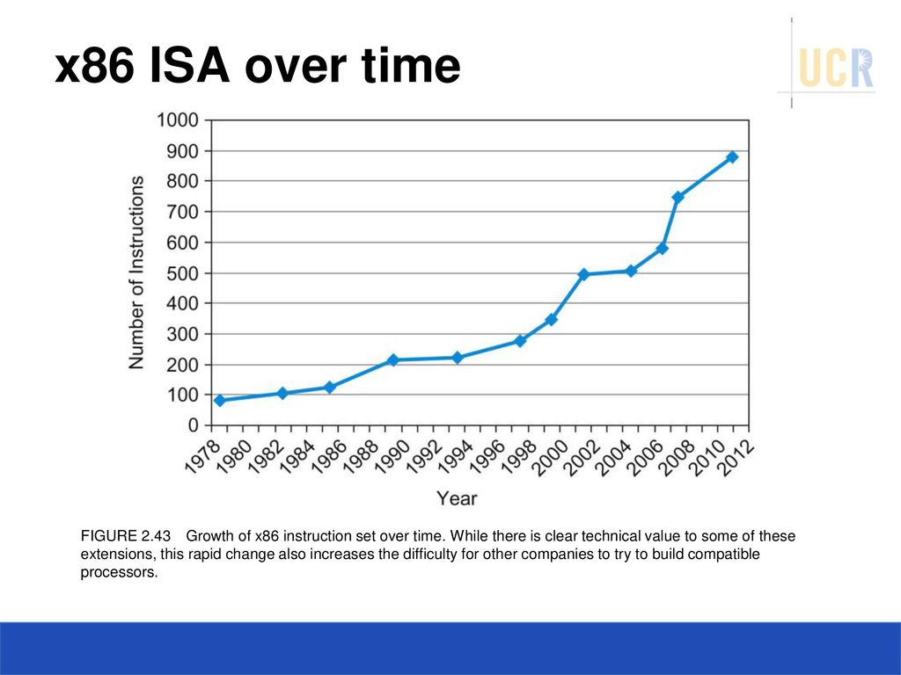
Fallacies: wrong concepts
More powerful instructions mean higher performance.
Write in assembly language to obtain the highest performance.
The importance of commercial binary compatibility means successful instruction sets don’t change.

Slide 33
Pitfalls
Forgetting that sequential word addresses in machines with byte addressing do not differ by one.
Using a pointer to an automatic variable outside its defining procedure.

Slide 34


